Slide 1



Offering an Elevated Patient Experience
Lessons from Cyprus & International Healthcare
Andros Antoniades, CEO Aretaeio Hospital
Hellenic Healthcare Group

Slide 2

What Do We Mean by Patient Experience?
Patient experience is the sum of every interaction a patient has with our system; before, during, and after care.
Is the operating cycle of a modern hospital system.
Patient experience is shaped by our culture,
our processes and our people:
how our systems work
how we communicate
how predictable, reliable and
trustworthy we are
how safe and respected patients feel

Slide 3

Why patient care matters
Patient experience is the central pillar of a successful, reputable and thriving hospital.
Positive experience influences patient outcomes, loyalty and your organization’s bottom line
Patients today are well informed and co-producers of care, not passive anymore
Experience affects trust, increase patient retention and reputation
Quality and experience are inseparable

Slide 4
Patient experience happens across the journey
Before admission
At admission
During hospitalisation
At discharge
After discharge
“This experience is not created by one person — it is created by the system.”

Slide 5

How to elevate patient experience?
Lessons learned from Cyprus & International Hospitals
Measurement enables improvement
Redesign patient journey
Communication failures matter most
Employee engagement
Digital works only if reliable
Patient engagement
Leadership Role

Slide 6
Lesson 1: Measure & Act
Lessons learned from Cyprus & International Hospitals
Measurement creates transparency and accountability
Systematic patient satisfaction measurement
Shift from anecdotes to data
Focus on patterns, not complaints
What gets measured gets managed — but only
if we act on it on confidentiality/quality/safety

Slide 7
Lesson 2: Redesign the patient journey (Lean Thinking)
Lessons learned from Cyprus & International Hospitals
1. Standardisation improves fairness and trust
  With HIO and broader system reforms, patients increasingly expect similar processes, similar access, similar information
Variation feels like unfairness,
even when care quality is good
2. Eliminate bottlenecks / waste in the process

Slide 8
Lesson 3: Standardize Communication & Service Recovery
Lessons learned from Cyprus & International Hospitals
Clear communication standards
Plain language
Service recovery when things go wrong

Slide 9

Lesson 4: Engage Employees
Lessons learned from Cyprus & International Hospitals
Engaged staff improve experience
Top drivers:
Protect, support, develop and train employees
Provide psychological safety
Streamline processes
Adequate staffing and balanced workload
Support teams to support patients
Employee engagement is not only an HR topic.
It is a patient experience strategy.

Slide 10
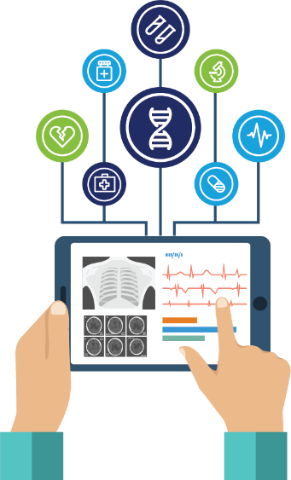
Lesson 5: Digital & Continuity
Lessons learned from Cyprus & International Hospitals
Digital creates value when it removes friction and reduces clinical risk
Reliability builds trust (a system that works every time builds trust to the patient)
Elevate experience by designing continuity: the patient should never wonder “what happens next”

Slide 11

Lesson 6: Patient Engagement
Lessons learned from Cyprus & International Hospitals
Patient engagement: from passive care to active partnership
Shared decision-making
Clear understanding &
health literacy
Digital tools that empower patients
Support for self-management

Slide 12
Lesson 7: Leadership Role
Lessons learned from Cyprus & International Hospitals
Be visible
Listen to patients and staff
Remove barriers

Slide 13
Closing Message
Experience is designed
Small changes done consistently / continuous improvement
Leadership makes the difference
Reliability, clarity, and respect define excellent care.

