Slide 1

Alsace
The Positive Healthcare System
DANIEL COUNIO
FOUNDER OF THE CYPRUS INTERNATIONAL MEDICAL FORUM
Editor-in-Chief of YACHT WAY Magazine
Author of “The Magic Temple of Luxury in the Hospitality and Yacht Industry”.
Officially approved instructor by the Cyprus Human Resources Development Authority (ANAD) Αρχής Ανάπτυξης Ανθρώπινου Δυναμικού Κύπρου (ΑνΑΔ) &
The European Qualifications with Certification Diploma Number: SEP004196

Slide 2
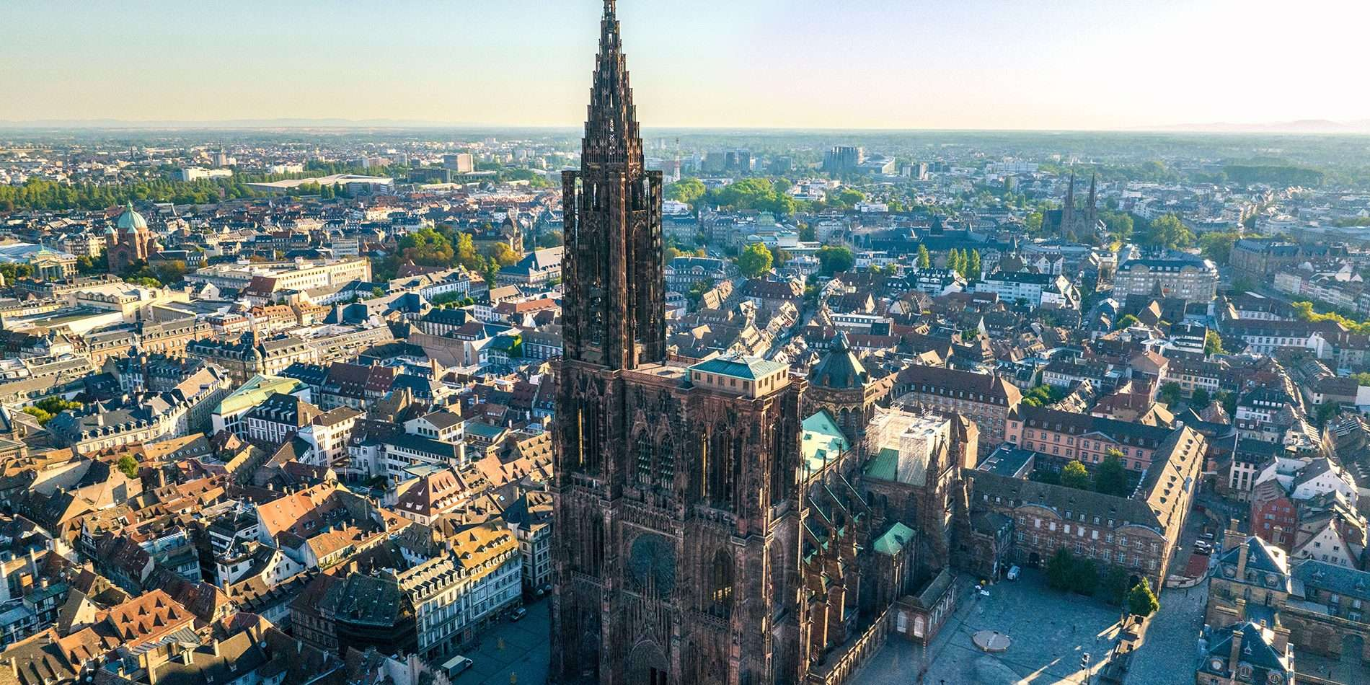


Strasbourg, has its name since 590 and is the
Capital of Alsace
also the European Capital since 1949…
Its Cathedral started in 1015 and finish in 1439
It was the tallest building in the world
for 2 centuries…

Slide 3
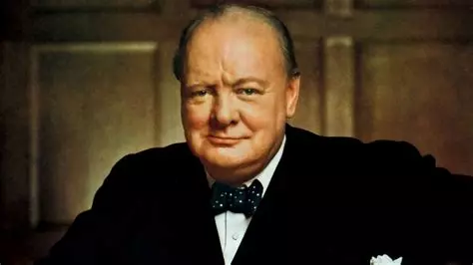
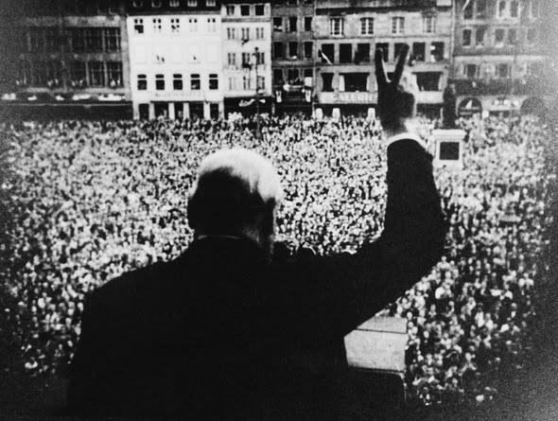
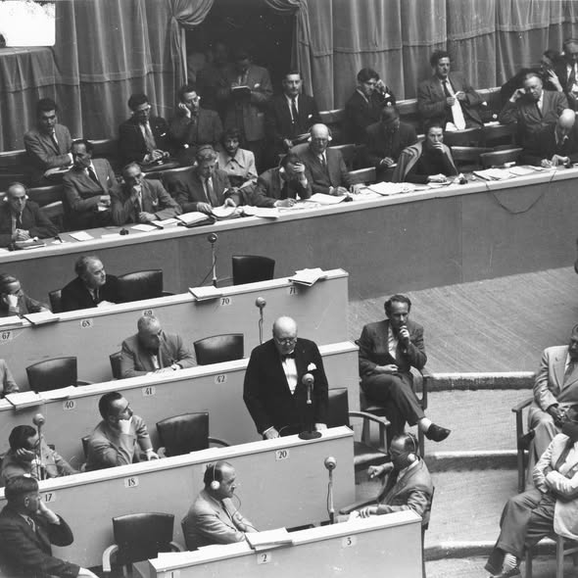
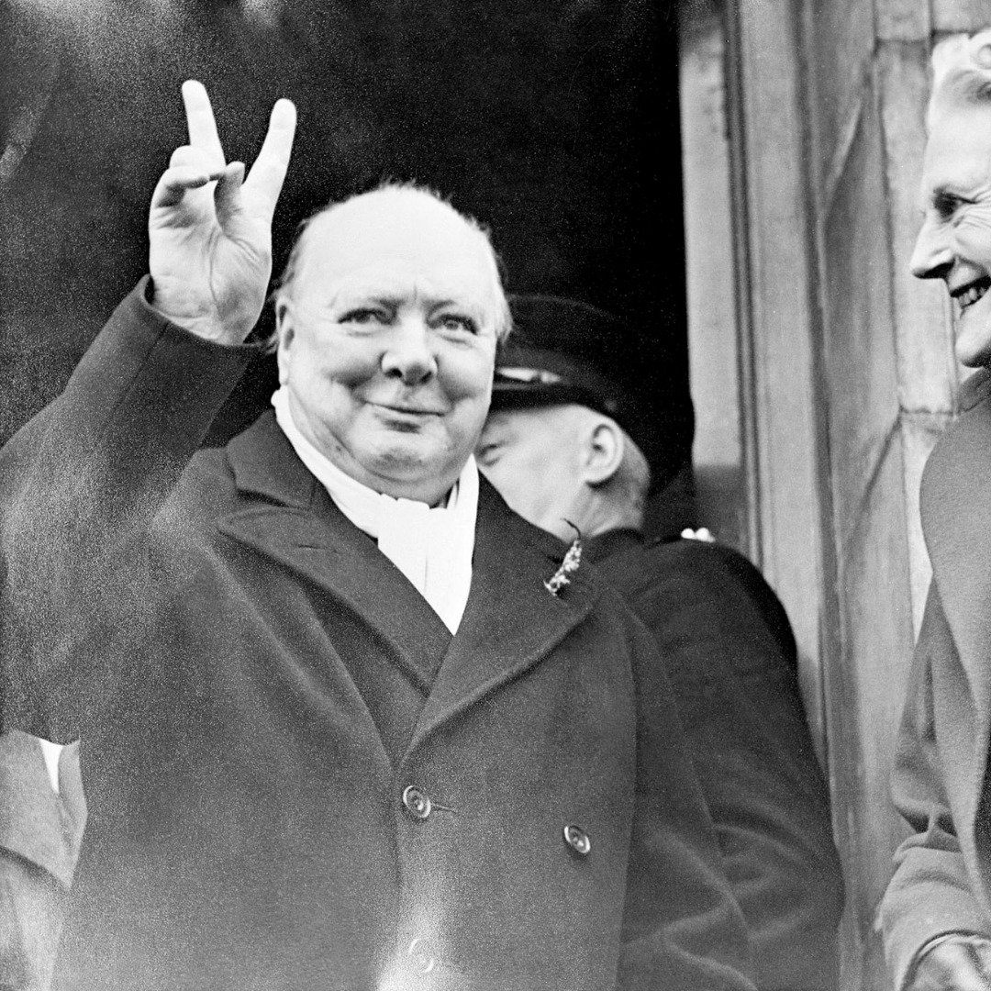
Sir Winston Leonard Spencer Churchill desire to see Strasbourg become a hub of European unity after the Second World War was a key element in Franco-German reconciliation and the creation of the Council of Europe.
His vision directly led to the establishment of European institutions in Strasbourg.
“Beware! I am going to speak in French!”
Winston Churchill addresses a vast crowd at
place Kléber in Strasbourg on the occasion of the first session of the Consultative Assembly
later to become the “Parliamentary” Assembly –
of the Council of Europe.

Slide 4
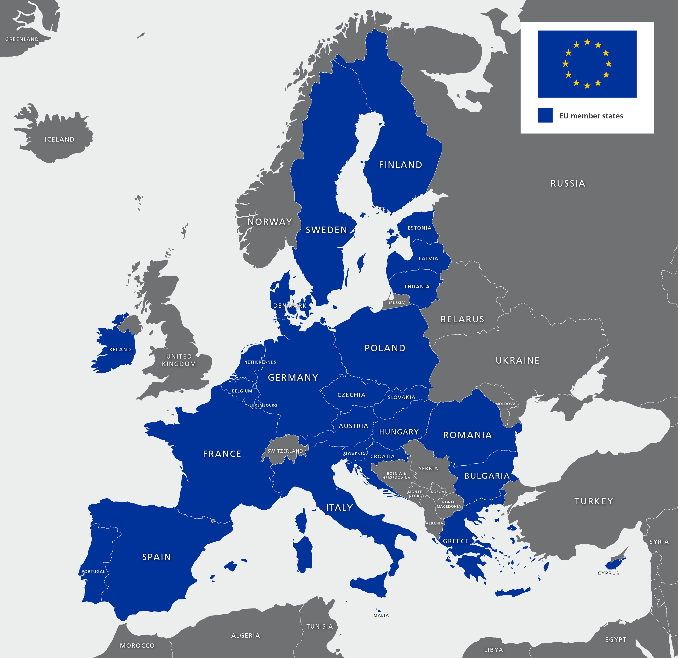
Belgium
The deficit in the social security system is €7.6 billion in 2025 . If current policies remain unchanged, this figure will even exceed
€14 billion in 2029.
France
2026 Budget:
the increase in the Social Security deficit, estimated at
€ 23 billion in 2025
Italy
for 2026 indicates that the social security deficit could be between €24 - € 28.7billion
Finland
2025 Social Security / Social Insurance deficit
€1 billion to €1.5 billion

Slide 5
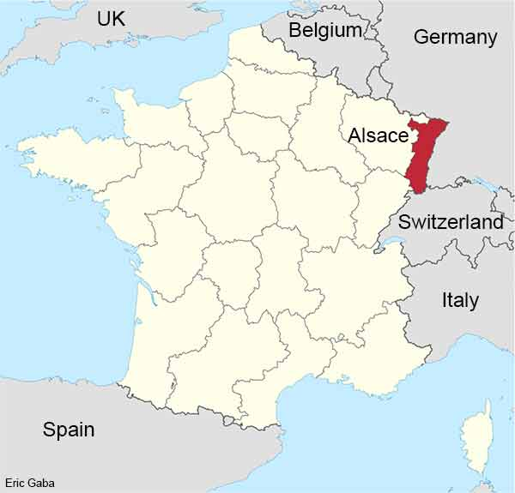

Alsace -Moselle
has a local health insurance scheme that is different from the rest of France and unique in Europe.
It is:
• Mandatory
• Public
• Region-specific
• Financially autonomous
• And in surplus !

Slide 6
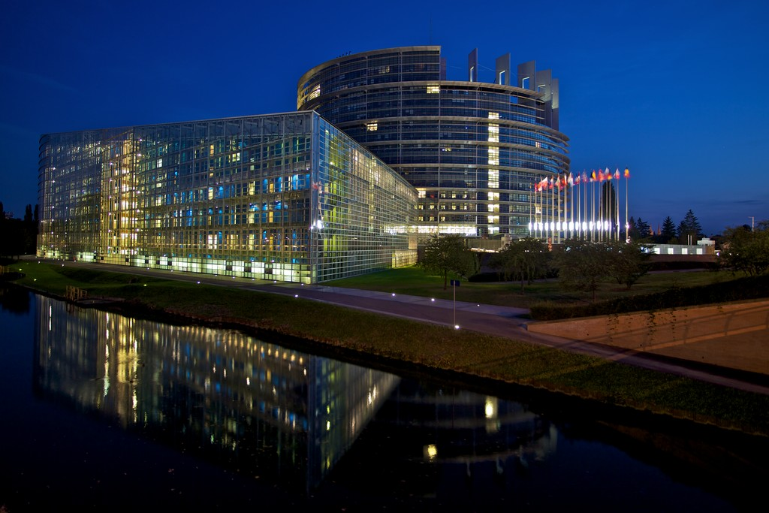
Alsace-Moselle is a unique example in Europe for its positive social security budget.
2024 Revenue from 480 / 538.5 million €
- 26,2 million €
2023 - 0,2 million €
+ 20 million €
2021 + 62,2 million €
+ 40 million €
+ 32,5 million €
+ 8,8 million €
+ 3,2 million €
Thanks to the efficient management of structural funds and the transfer of responsibility for managing EU programs,
the region has largely achieved its objectives
This experience is considered a benchmark for other European regions calling for greater decentralization
in the management of structural funds.

Slide 7


Component Standard France Alsace-Moselle
Employee social contributions
on €2 000 ~€440–€500 ~€466–€526
Difference (local surcharge) 0 €26 extra / month
What this €26/month gets you
In Alsace-Moselle, that local 1.30 % gives you:
✔ Higher reimbursement of medical consultations
✔ Better hospitalization coverage
✔ Improved transport and medical benefits
✔ Lower out-of-pocket costs than the rest of France
This local charge is not a tax, but a social contribution tied to health insurance benefits specific to the region’s historic regime
Only applied to employees

Slide 8

At the global level:
The Alsatian model is often cited as a reference for
"Greater Social Security"
or
a high-performing single-payer system,
because it drastically reduces the need for expensive private mutuals,
unlike the US model
dominated by private insurance.

Slide 9


Could the Alsace model work in the Republic of Cyprus?
Conceptually: YES
The core principles of the Alsace model are compatible with Cyprus:
Mandatory public health coverage
Dedicated, earmarked contributions
Autonomous (but accountable) management
Strong cost control Clear link between benefits and financing
Cyprus already has something important in common with Alsace: a small population and centralized administration, which actually makes reform easier than in large countries.

Slide 10

How the Alsace model could be applied in Cyprus
Add a mandatory “top-up public layer”
Like Alsace
Cyprus could create:
A second public health layer, mandatory
Financed by a small additional employee contribution (1–1.5%)
Covering: Co-payments
Expanded dental care
Better outpatient coverage
Long-term care elements
This would reduce: Out-of-pocket payments
Dependence on private insurance

Slide 11

How the local health insurance works in ALSACE ?
Higher coverage
Compared to the French national system:
Doctor visits: ~90% reimbursed (vs ~70%)
Hospital care: 100% covered, including the daily hospital charge
Much lower out-of-pocket costs for patients
As a result, many people do not even need private health insurance.
Why the budget is often positive or balanced? This is the key point.
Dedicated financing
Employees pay a specific additional contribution
(around 1.3% of gross salary).
There is no employer contribution for this part.
The contribution is not capped, which makes revenues stable.
Autonomous governance?
The system is managed by a local board, mainly representing employees.
This board can:
Adjust contribution rates
Adjust benefit levels (within legal limits)
This creates direct financial responsibility: if costs rise, adjustments are possible.

Slide 12
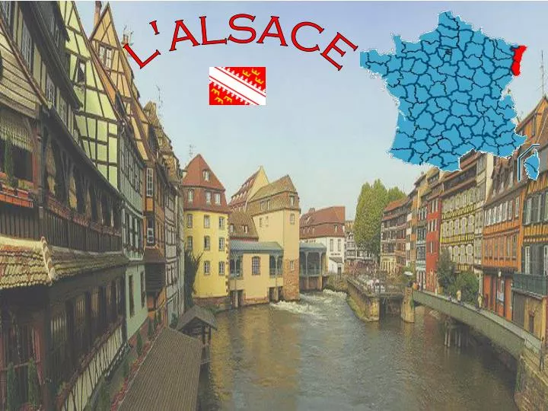
Key lesson from Alsace
Create autonomous governance
A separate fund from
the central state budget
Managed by a tripartite board:
Insured persons
Employers
State representatives
Legal obligation to keep the budget balanced
This is crucial:
➡️ No automatic bailout from the state
→ Strong financial discipline.

Slide 13
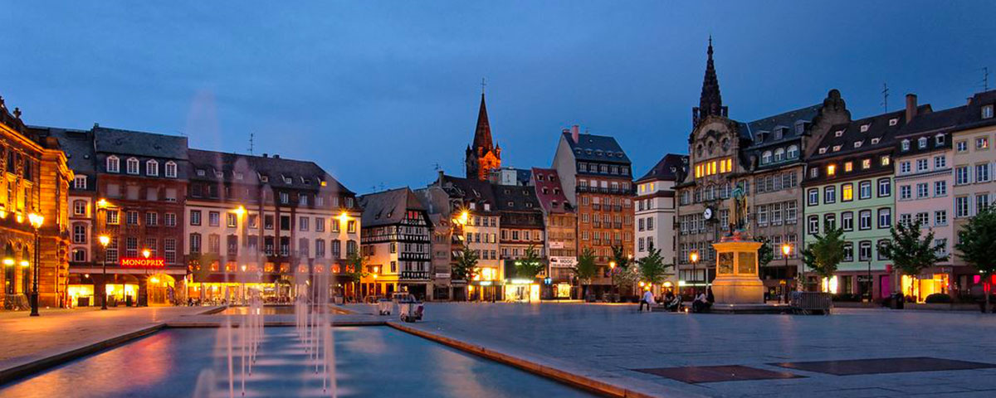

ALSACE HEALTHCARE
HAS
Very low administrative costs
Less than 1% of spending goes to administration.
efficiency is achieved through simplicity
No marketing, no competition, no profit motive.

Slide 14
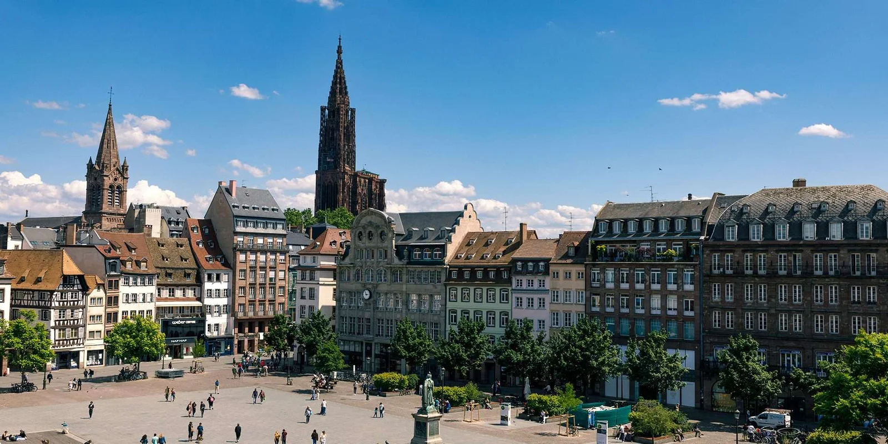
Decisions on contributions and benefits are taken locally.
Ability to adapt quickly when costs increase.

Slide 15

ALSACE IS
EU compatibility: fully YES
There is no EU legal obstacle:
Health systems are national competence
Mandatory public schemes are allowed
Regional or sectoral differentiation is legal
In fact, the EU generally encourages financially sustainable social models.
What Cyprus would gain?
More financial stability than pure tax-financed systems
Lower private insurance dependence
Stronger social solidarity
Predictable health financing
A model that can remain balanced long-term

